Slide 1




NEXT GEN EMPLOYABILITY PROGRAM
Creating a future-ready workforce
Team Members
College Name
Student Name : Haripriya S V
Student ID : 960221243023
Arunachala College of Engineering for Women

Slide 2

CAPSTONE PROJECT SHOWCASE
Project Title
Car Rental Web Application using Django Framework
Abstract | Problem Statement | Project Overview | Proposed Solution | Technology Used | Modelling & Results | Conclusion

Slide 3
Abstract
The Car Rental Web Application, powered by Django, revolutionizes the car rental experience by seamlessly connecting rental agencies and customers. It provides an intuitive interface for browsing, booking, and managing reservations, supported by a robust database storing car details, customer profiles, and booking records. This ensures precision and reliability in every interaction, from vehicle selection to reservation confirmation. Django's versatile views serve as the backbone of the application, orchestrating seamless interactions and delivering prompt responses to user queries and actions. Security is a top priority, with strict authentication and authorization mechanisms safeguarding user data.
Dynamic input forms, powered by Django's form-handling capabilities, enhance user experience by providing intuitive interfaces for data input. Users can submit booking details or update personal information effortlessly.
Its modular design facilitates the integration of new features and functionalities, ensuring continuous innovation.
In summary, the Car Rental Web Application redefines car rental management standards, offering a comprehensive and user-centric solution that enhances customer satisfaction, drives operational efficiency, and empowers rental agencies to thrive in a competitive market.
Source :

Slide 4
Problem Statement
The current car rental industry lacks a comprehensive digital solution that seamlessly connects rental agencies with customers, resulting in inefficiencies in booking processes and customer satisfaction. To address this gap, we propose the development of a Car Rental Web Application using the Django framework. This application aims to provide an intuitive platform for users to browse, book, and manage car rentals efficiently, while also offering rental agencies a streamlined system for managing inventory and bookings. By leveraging Django's robust features for database management, user authentication, and dynamic content generation, the goal is to create a scalable and secure solution that enhances the overall rental experience for both agencies and customers, ultimately driving operational efficiency and improving customer satisfaction.
Source :

Slide 5
Project Overview
The Car Rental Web Application aims to streamline the car rental process by providing a user-friendly platform for both rental agencies and customers. Leveraging Django's robust features, the application facilitates efficient browsing, booking, and management of car rentals. Users can easily search for available vehicles, make bookings, and manage reservations, while rental agencies can efficiently manage their inventory and bookings. Security measures such as user authentication ensure data protection. Dynamic forms enhance user experience, adapting to various input requirements. The application follows the MVC architecture, ensuring scalability and flexibility to meet industry demands. Overall, the project seeks to enhance customer satisfaction and drive operational efficiency within the car rental industry through a comprehensive and intuitive digital solution.
Source :

Slide 6
Proposed Solution
In response to the existing inefficiencies within the car rental industry, the proposed Car Rental Web Application stands as a transformative solution, harnessing the power of the Django framework to revolutionize rental processes for both agencies and customers. This innovative platform is designed to provide a seamless and intuitive experience, offering comprehensive features for browsing, booking, and managing reservations.
Key Features:
User-Friendly Interface: At the heart of the application lies a user-friendly interface that simplifies the car rental experience. Customers can effortlessly browse through available vehicles, view detailed information, and make bookings with ease. Rental agencies, on the other hand, are equipped with intuitive tools for managing their inventory and handling customer reservations efficiently.
Robust Database Management: Leveraging Django's Object-Relational Mapping (ORM) capabilities, the application ensures efficient storage and retrieval of critical data, including car details, customer information, and booking records. This robust database management system forms the backbone of the application, facilitating quick and accurate access to essential information.
.
Source :

Slide 7
Secure Authentication: Security is a top priority, and the application implements robust authentication mechanisms to safeguard user data and protect against unauthorized access. Through secure authentication protocols, users can trust that their personal information remains protected throughout their interactions with the platform.
Dynamic Forms: Django's powerful form-handling capabilities enable the creation of dynamic and adaptable input forms, enhancing the user experience and simplifying data submission. Whether it's submitting booking details or updating personal information, users can navigate through the application seamlessly, thanks to its intuitive form workflows.
Scalability and Flexibility: The application is designed following the Model-View-Controller (MVC) architecture, ensuring scalability and flexibility to accommodate future enhancements and changes in industry demands. This modular design approach allows for seamless integration of new features and functionalities, ensuring that the application remains adaptable to the evolving needs of the car rental industry.
Responsive Design: With a focus on accessibility, the application boasts a responsive web design that ensures compatibility across various devices and screen sizes. Whether accessing the platform from a desktop computer, tablet, or smartphone, users can expect a consistent and optimized experience tailored to their device.
Source :

Slide 8
Efficient Booking Workflow: Streamlining processes is key to enhancing user satisfaction, and the application achieves this through efficient booking workflows. By minimizing user effort and automating repetitive tasks, the application ensures that customers can complete their bookings quickly and easily, resulting in a more efficient and satisfying experience overall.
Comprehensive Admin Dashboard: For rental agencies, the application provides a comprehensive admin dashboard that offers insights into inventory management, booking analytics, and customer interactions. This robust interface empowers agencies to make informed decisions and optimize their operations for maximum efficiency and profitability.
Objective:
The objective of the Car Rental Web Application is clear: to enhance customer satisfaction and drive operational efficiency within the car rental industry. By offering a user-centric platform that prioritizes usability, security, and scalability, the application aims to redefine the car rental experience, making it more seamless, intuitive, and enjoyable for both agencies and customers alike.
Source :

Slide 9


Technology Used
Front-end
Back-end
Source :

Slide 10
Modelling & Results
Utilizing Django's ORM, the application models key entities such as Car, Customer, and Booking. These models define the structure and relationships between data, ensuring efficient storage and retrieval. For example, the Car model includes fields for make, model, year, price per day, and availability.
During development, rigorous testing ensures the application's functionality and reliability. Unit tests verify individual components, while integration tests validate interactions between different modules. User acceptance testing ensures that the application meets user requirements and expectations.
Upon deployment, the Car Rental Web Application undergoes continuous monitoring to identify and address any issues promptly. Performance metrics such as response time and system uptime are monitored to ensure optimal performance.
The results of the Car Rental Web Application are promising, with increased efficiency in booking processes and improved customer satisfaction. Agencies benefit from streamlined inventory management, while customers enjoy a seamless booking experience, leading to enhanced business success and growth within the car rental industry.
Source :

Slide 11
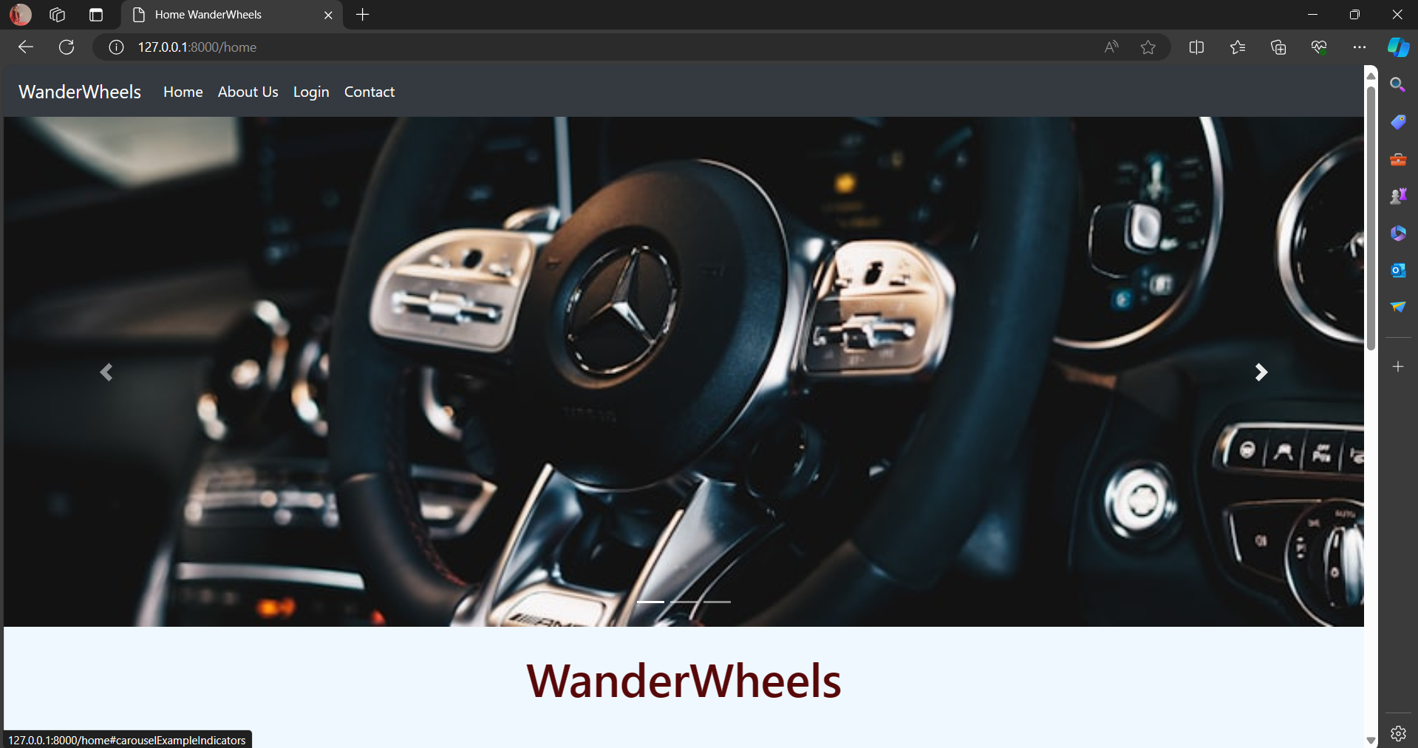
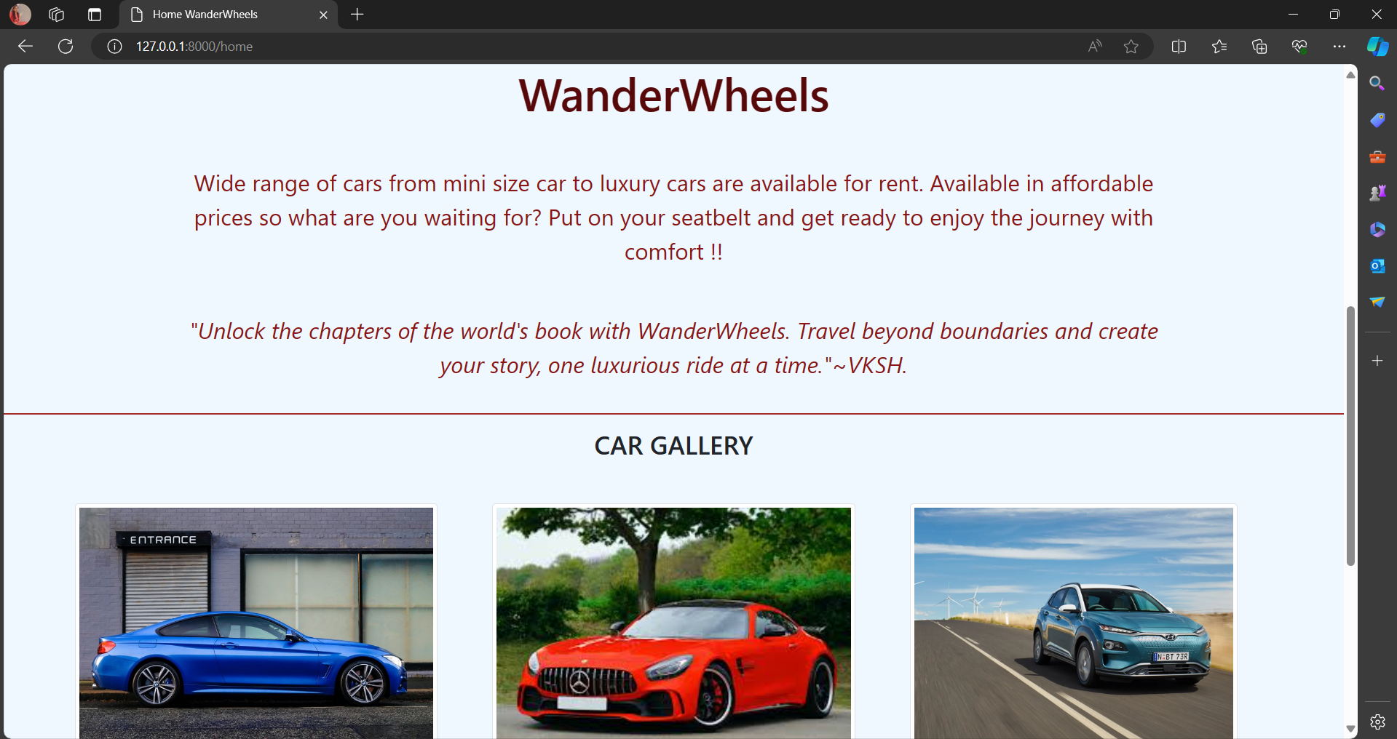
Homepage

Slide 12
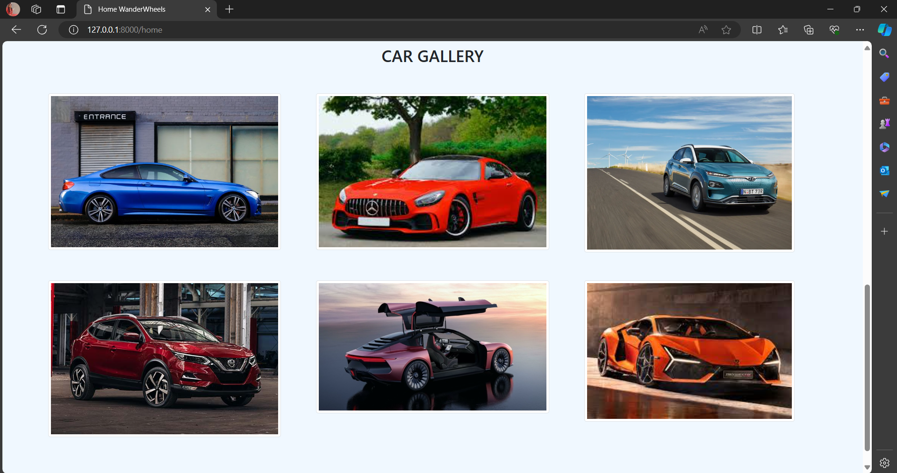

Slide 13
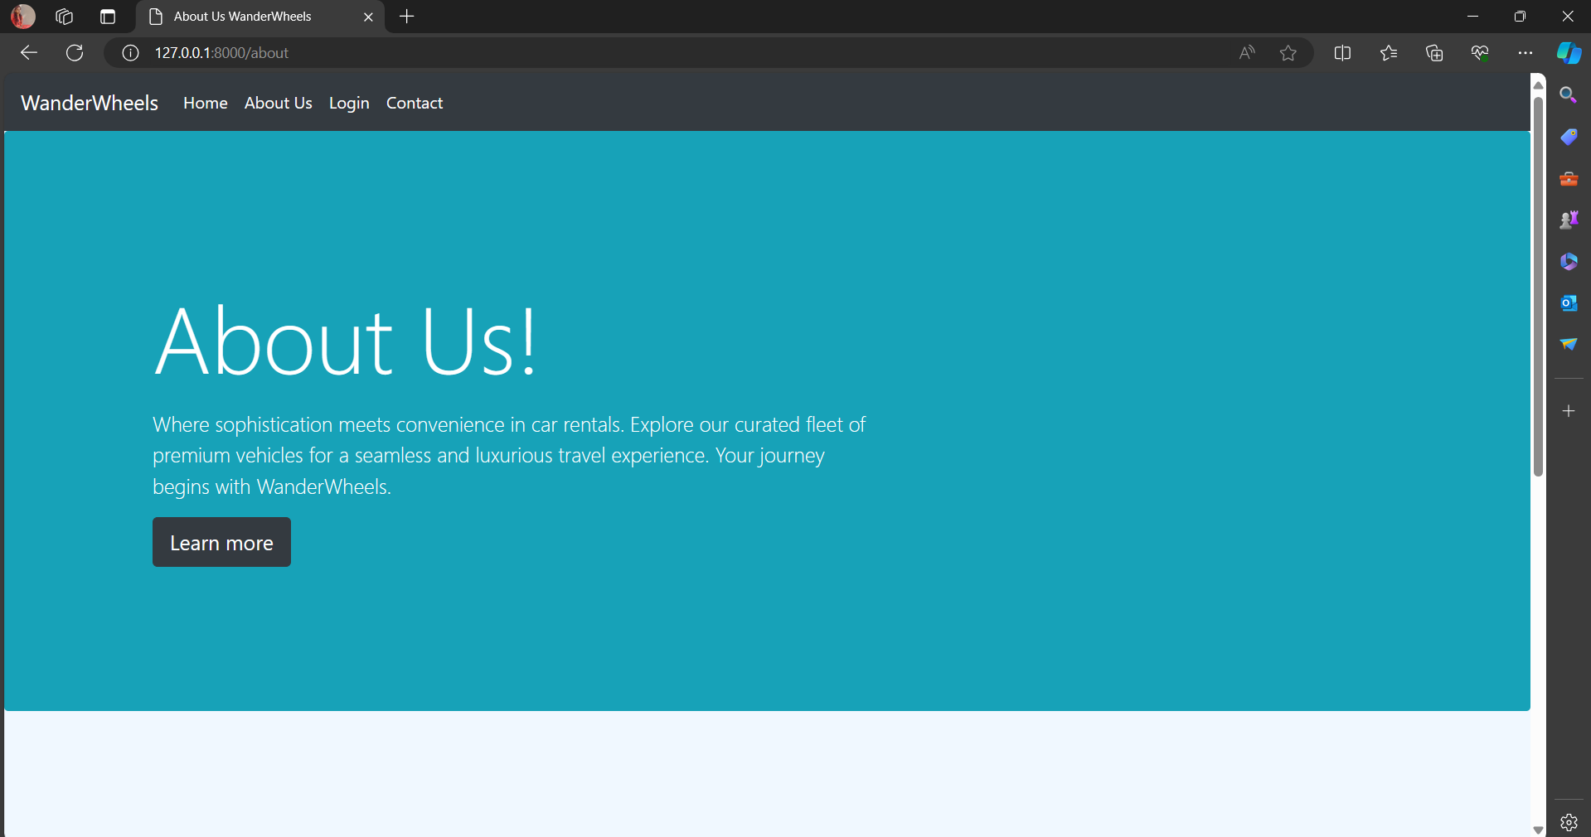
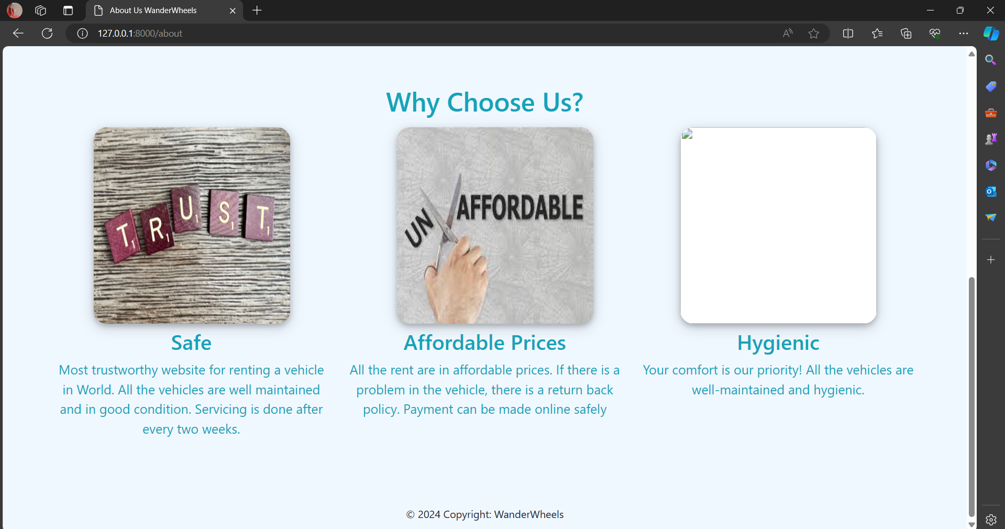
About-Us-Page

Slide 14
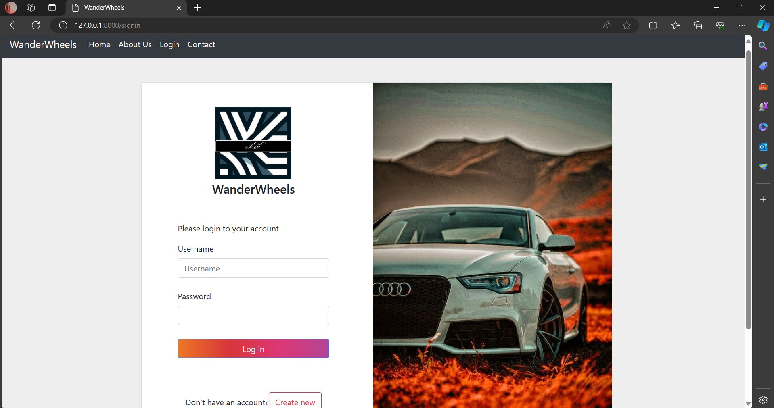
Login page

Slide 15
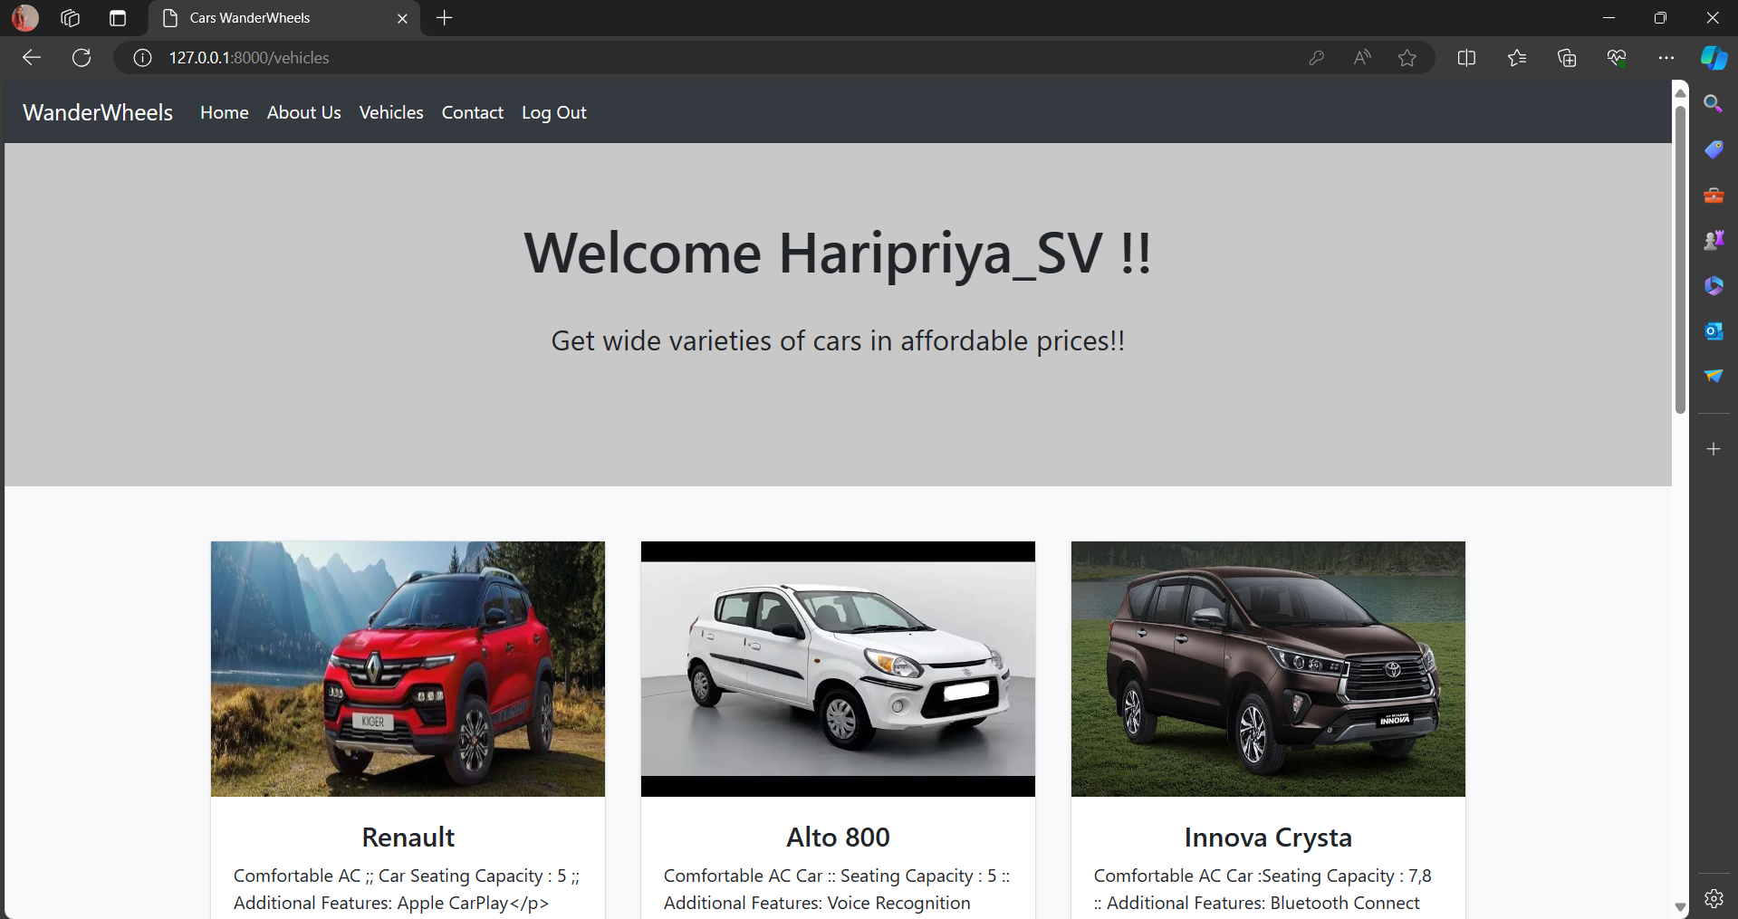
Departments-Page

Slide 16
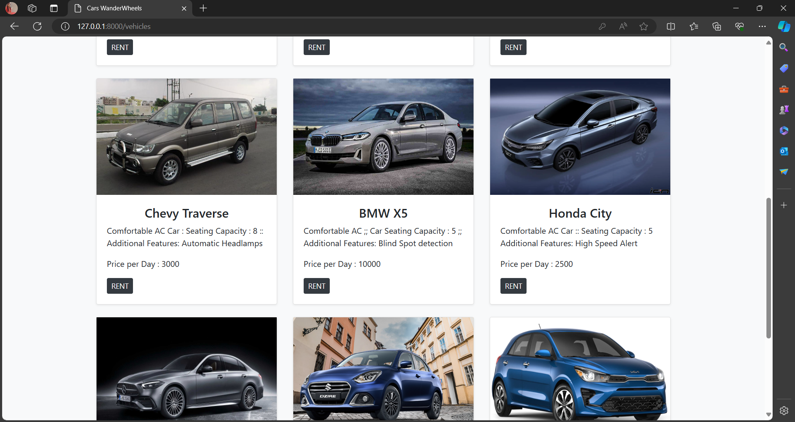

Slide 17
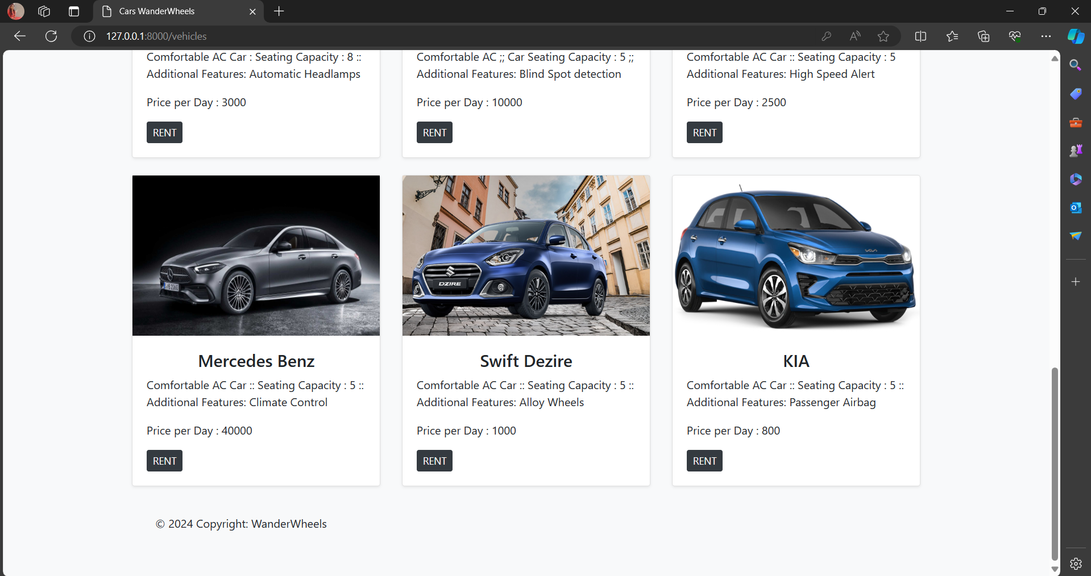

Slide 18
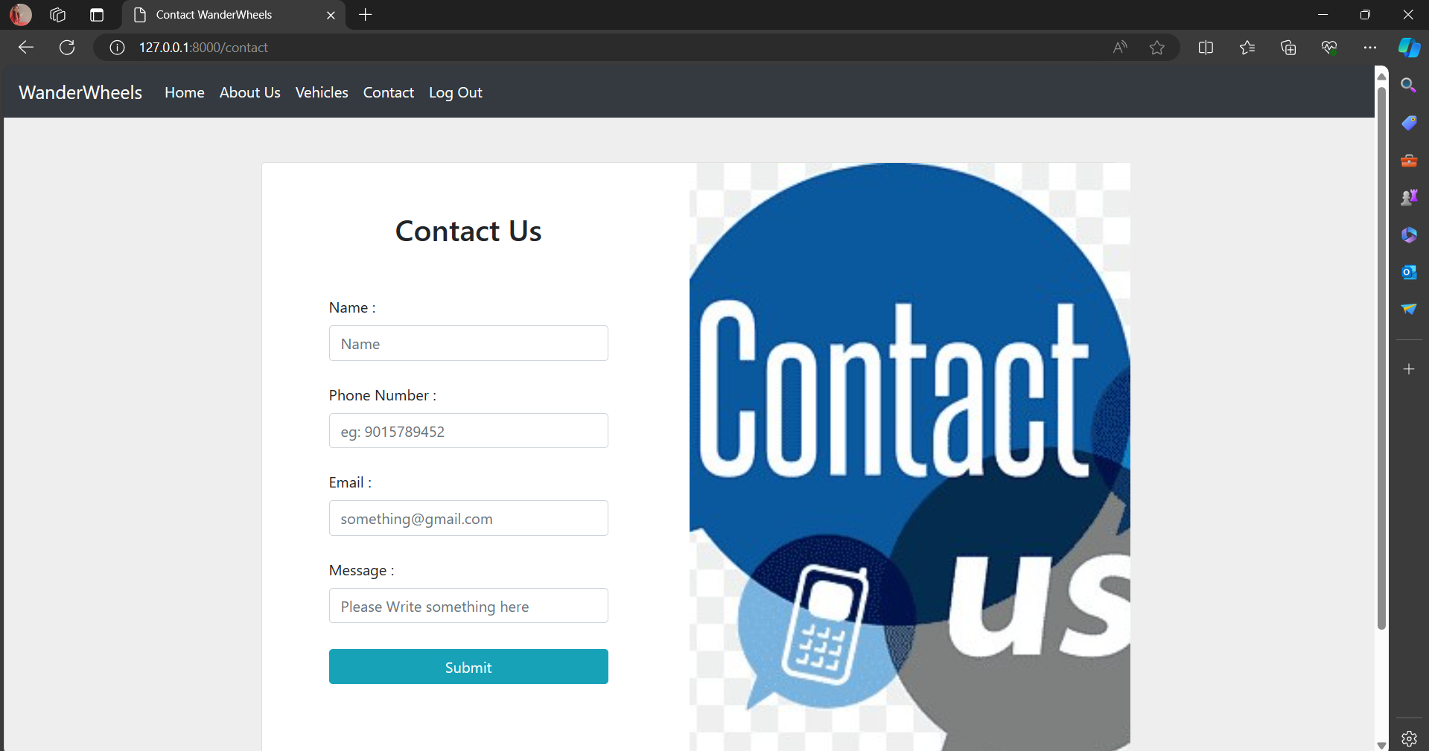
Contact us

Slide 19
Future Enhancements:
Future Enhancements:
Payment Integration: Integrate secure payment gateways for online bookings, enhancing convenience and reducing administrative workload.
Feedback System: Implement a feedback and review system for customers to share rental experiences, fostering transparency and improving service quality.
Advanced Search Filters: Enhance browsing with advanced filters for vehicle features and customer preferences, improving user experience.
Predictive Analytics: Utilize predictive analytics to forecast demand and optimize inventory management, maximizing revenue and minimizing stockouts.
Mobile App: Develop a mobile companion app for on-the-go access to booking services and real-time notifications.
Vehicle Tracking Integration: Integrate with GPS tracking systems for real-time vehicle location updates, enhancing security measures.
Multi-Language Support: Implement multi-language support for a more inclusive user experience.
Dynamic Pricing: Introduce dynamic pricing algorithms based on demand and availability, optimizing revenue and utilization.
Digital Inspection Checklist: Offer a digital vehicle inspection checklist for transparency and accountability.
Travel Platform Integration: Partner with travel booking platforms to expand reach and offer integrated car rental services.

Slide 20
Conclusion
The Car Rental Web Application, developed using Django, represents a significant step towards transforming the car rental industry. By offering intuitive browsing, booking, and management features, it enhances both customer satisfaction and operational efficiency for rental agencies. With secure payment integration, advanced search filters, and predictive analytics, the platform adapts to evolving industry needs while ensuring transparency and accountability through feedback systems and digital inspection checklists. Future enhancements such as mobile app development and integration with travel platforms promise further growth and expansion opportunities. In conclusion, the Car Rental Web Application stands as a testament to innovation and customer-centricity, poised to redefine the car rental experience and drive business success in the digital age.
Source :

Slide 21
Thank You!
Notes:
Thank You !!

